Slide 1
Chapter 5
Dynamic Programming-
Reliability Design
TSP

Slide 2
Dynamic Programming
Used when the solution of a problem is a result of a sequence of decisions
Example
  Knapsack
  Shortest path
  Optimal merge patterns

Slide 3
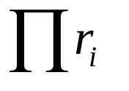
Reliability design
Solve a problem with a multiplicative optimization function
Several devices are connected in series
r_{i} be the reliability of device D_{i}
Reliability of the entire system
Duplicate : multiple copies of the same device type are connected in parallel use switching circuits

Slide 4
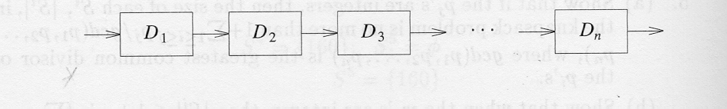
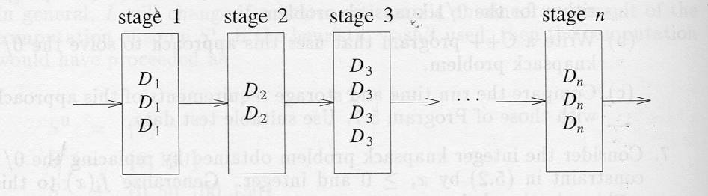
Reliability design
n devices D_{i}, 1<=i<=n, connected in series
Multiple devices connected in parallel in each stage

Slide 5
Travelling Salesperson Problem
(TSP)
Very famous problem
Many practical applications
Very easy to describe
Very difficult to solve

Slide 6
Problem Formulation
There are many ways to describe this problem.
We shall consider the following:
  English version
  Linear Programming oriented version

Slide 7
English Version
You are given a set of n cities
You are given the distances between the cities
You start and terminate your tour at your home city
You must visit each other city exactly once.
Your mission is to determine the shortest tour.

Slide 8
TSP Version 1 (LP)
Decision variable:
A boolean matrix x interpreted as follows:
x(i,j):= 1, iff we go from city i to city j.
x(i,j) := 0, otherwise

Slide 9
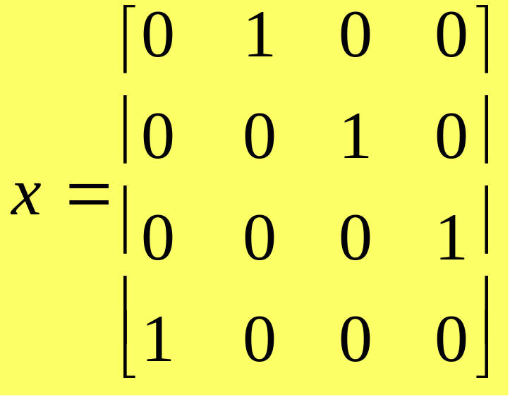
Example
This matrix represents the tour (1,2,3,4,1)

Slide 10
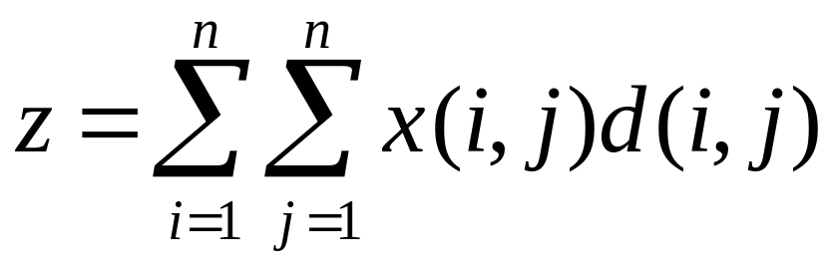
Objective function
d(i,j) = (direct) distance between city i and city j.

Slide 11
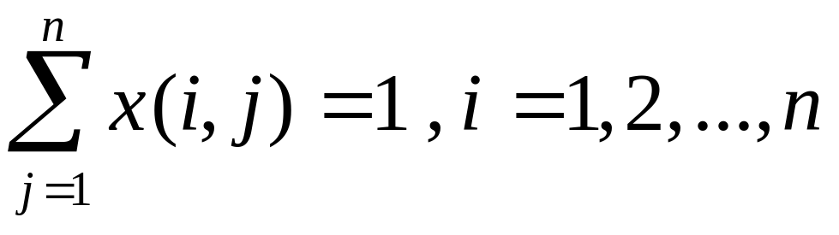
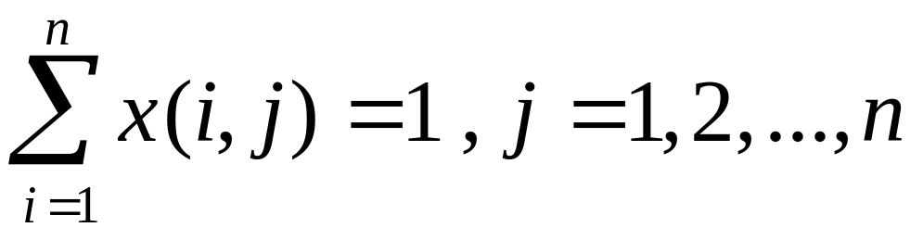
Constraints
Each city must be “exited” exactly once
Each city must be “entered” exactly once

Slide 12
Time Complexity
TSP time complexity is exponential

Slide 13
Basic Idea TSP
Let G(V,E) be directed graph with edge
cost C_{ij}
A tour of G is a Directed simple cycle that
includes every vertex in V
The cost of tour is sum of weights of the
edges on tour
TSP is the minimum cost tour
Basically it is a permutation problem

Slide 14
Logic
If we have n cities then we can have
(n-1)! Permutations.
If n=4
    1-2-3-4-1
    1-2-4-3-1
    1-3-2-4-1
    1-3-4-2-1
    1-4-3-2-1
    1-4-2-3-1 there are 6 possible ways(3!)

Slide 15
Brute force method
Try all (n-1)! Feasible solutions
Other way
Apply dynamic programming

Slide 16
Dynamic approach
We can start the tour from any vertex and reach the same vertex
Let tour starts at vertex 1and each tour consists of an edge<1,k> for some k
belongs to V-{1} and a path from vertex k to vertex 1 going through all vertex in v-{1,k} exactly once

Slide 17
Dynamic approach
It follows the principle of Optimality
Let g(i,S) = length of shortest path
from node i and going through all vertices in S and terminating at node1.
g(1,V-{1}) is optimal length tour
g(i,S) = min{Cij+g(j,S-{j})}
i is the starting node and S is the set of remaining nodes other then node i.

Slide 18
Example
g(i,∮) = Ci1 for 1<=i<=n
For S =0
i.e. No intermediate nodes are there.
Cost of moving from vertex 1
to itself
g(1,∮) = 0
g(2, ∮) = start at node 2 and end at node 1
= C21=5 similarly
g(3, ∮) = C31 =6
g(4, ∮) = C41 =8
0 | 10 | 15 | 20
5 | 0 | 9 | 10
6 | 13 | 0 | 12
8 | 8 | 9 | 0
 | 1 | 2 | 3 | 4
1 | 0 | 10 | 15 | 20
2 | 5 | 0 | 9 | 10
3 | 6 | 13 | 0 | 12
4 | 8 | 8 | 9 | 0

Slide 19
Example
When S =1; there is one node in the set.
Node 1 is already done.
g(2,{3}) = C23+g(3, ∮) = 9+6 =15
g(2,{4}) = C24 +g(4, ∮)= 10+8=18
g(3,{2}) = C32 +g(2, ∮)= 13+5=18
g(3,{4}) = C34+ g(4, ∮) = 12+8=20
g(4,{2}) =13; g(4,{3}) = 15

Slide 20
Example
When set S =2; two nodes are there in the set.
Continue the tour from node 2
g(2,{3,4}) indicates that starting from node 2 then
passing through 3,4 and reaching 1.
Since we have 2 nodes in between so we need to take the min path, either 2-3-4 or 2-4-3 using
the formula
g(i,S) = min { Cij + g(j, S-{j})}

Slide 21
Example
g(2,{3,4}) = min{C23+g(3,{4}), C24+g(4,{3})}
= min{27,25} = 25
g(3,{2,4}) = min{c32+g(2,{4}),C34+g(4,{2})} =25
g(4,{2,3})= min{C42+g(2,{3}),C43+g(3,{2})=23

Slide 22
Example
Set S = 3
G(1,{2,3,4}) = min{ C12+g(2,{3,4}), C13 + g(3,{2,4}), C14+g(4,{2,3})
Min{35,40,43}
Optimal tour length =35
Path is
(1,{2,3,4}) = 2 ; (2,{3,4}) =4;
(4,{3}) = 3; cycle is 1-2-4-3-1

